Slide 1
The Fundamental of Mobile Robot
Machine Perception and Interaction Group (MPIG)
http://www.mpig.com.cn
szl@mpig.com.cn

Slide 2



All the codes and slides accompanying the course are open-source
https://github.com/sunzuolei/robot
https://git.oschina.net/samuel/rob

Slide 3
Localization with Histogram Filter

Slide 4

Our robot has no clue where it is.

Slide 5

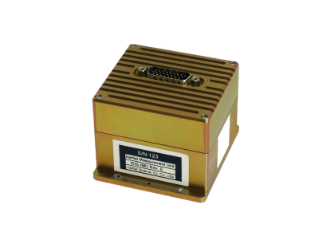
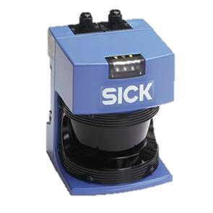

Our robot has no clue where it is.
GPS-liked localizer is not reliable.
We need sensors and the algorithms
for data cooking.

Slide 6
Let's assume there are 3 different landmarks in the world. they all look alike, so they're not distinguishable, but robot can distinguish the door from the non-door area--from the wall.

Slide 7
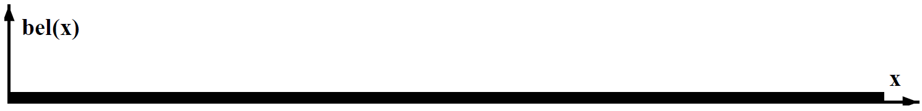
Uniform function assigns equal weight to every possible place where the robot might be.
bel stands for belief. You may treat it as probability.

Slide 8
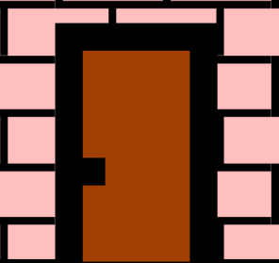
By sensing with a camera, the robot knows that it is now located, likely, next to a door.

Slide 9
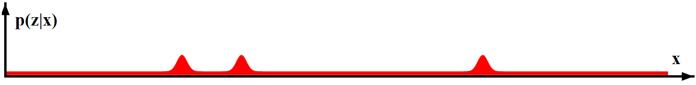
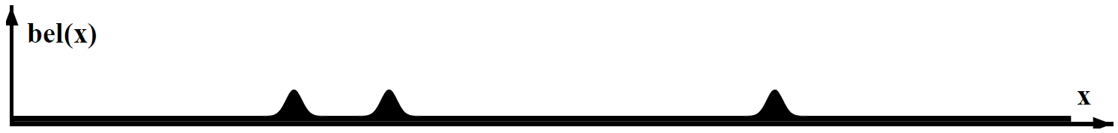

Slide 10
Robot moves to the right by a certain distance. And It knows roughly how far it moved.

Slide 11
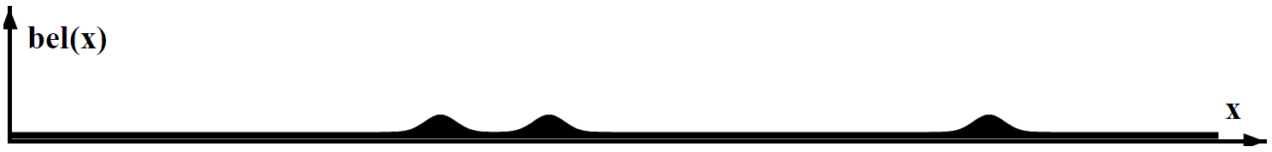
Convolution
The belief is shifted according to the motion. Now, robot motion is somewhat uncertain. We can never be certain where the robot moved. So these bumps are a little bit flatter than they were.

Slide 12
The robot senses again with its camera.

Slide 13
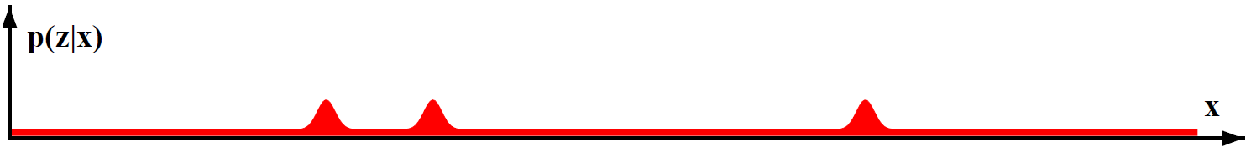

How will the belief like?

Slide 14
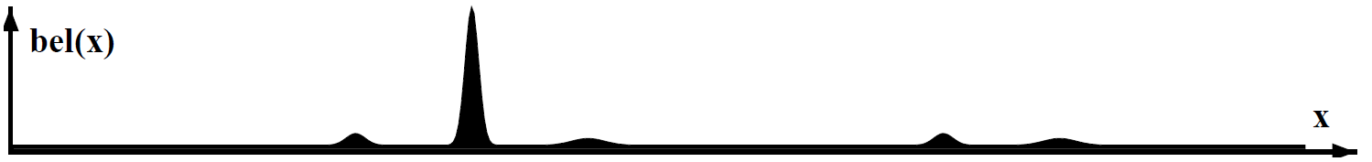
The robot has localized itself!!

Slide 15
It is a core aspect of
localization especially
of mobile robot!

Slide 16
Prior
Observation model / Sensor model
Posterior

Slide 17
Prior
The probability before considering data (measurement)
Posterior
The probability after data (measurement) has been taken.

Slide 18
Prior
Observation model / Sensor model
Posterior
Process model / Motion model
Observation model / Sensor model
Posterior

Slide 19
Prior
Observation model / Sensor model
Update / Measurement update
Posterior
Predict / Process update
Process model / Motion model
Observation model / Sensor model
Update / Measurement update
Posterior

Slide 20
Update / Measurement update
Prior
Posterior
Predict / Process update

Slide 21
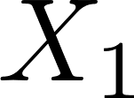
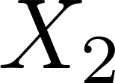
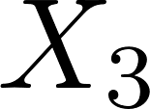
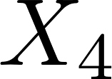
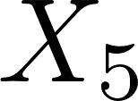
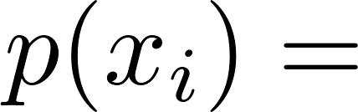
A world with 5 different cells or places
What is the probability of any of those x's?

Slide 22
0.2
A world with 5 different cells or places
What is the probability of any of those x's?
The total probability equals 1

Slide 23
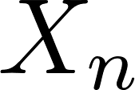
…
A world with n different cells or places
What is the probability of any of those x's?

Slide 24
…
1/n
A world with n different cells or places
What is the probability of any of those x's?
Let’s implement this！

Slide 25
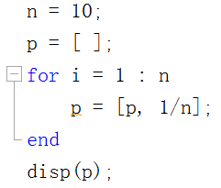
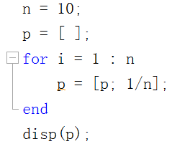
…
OR
What’s the difference?
Are they problematic?
P1

Slide 26
…
Explanation The size of the indicated variable or array appears to be changing with each loop iteration. Commonly, this message appears because an array is growing by assignment or concatenation. Growing an array by assignment or concatenation can be expensive. For large arrays, MATLAB must allocate a new block of memory and copy the older array contents to the new array as it makes each assignment. Programs that change a variable's size in this way can spend most of their run time in this inefficient activity.
For the same reasons, there is significant overhead in shrinking an array or in changing the size of a variable on each iteration.
P1

Slide 27
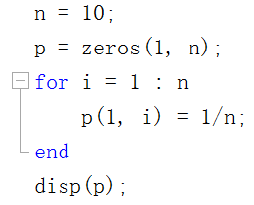
…
P1

Slide 28
0.2
0.2
0.2
0.2
0.2
Now that we can establish the robot's initial belief about its location in the world, we want to update these beliefs given a measurement from the robot's sensors.

Slide 29
0.2
0.2
0.2
0.2
0.2
Let's assume 2 of those cells are colored red whereas the other 3 are green.

Slide 30
0.2
0.2
0.2
0.2
0.2
Red cell * 0.6
Green cell *0.2
Sensors are incorrect, so we do not want to multiply the green cell probability by zero. Instead, we multiply it by 0.2!

Slide 31
Red * 0.6
Green *0.2
0.2
0.2
0.2
0.2
0.2
What are the probabilities that the robot is in a red cell and the green cell?

Slide 32
Red * 0.6
Green *0.2
0.2
0.2
0.2
0.2
0.2
0.04
0.12
0.12
0.04
0.04
Find the probability for each cell by multiplying the previous by the new factor, whose value depends on the color of the cells.

Slide 33
Red * 0.6
Green *0.2
0.2
0.2
0.2
0.2
0.2
0.04
0.12
0.12
0.04
0.04
Is this a valid probability distribution?

Slide 34
Red * 0.6
Green *0.2
0.2
0.2
0.2
0.2
0.2
0.04
0.12
0.12
0.04
0.04
0.04*3+0.12*2 = 0.36
NO! they do not add up to one.

Slide 35
Red * 0.6
Green *0.2
0.2
0.2
0.2
0.2
0.2
0.04
0.12
0.12
0.04
0.04
0.04*3+0.12*2 = 0.36
How can we normalize it?

Slide 36
Red * 0.6
Green *0.2
0.2
0.2
0.2
0.2
0.2
0.04
0.12
0.12
0.04
0.04
1/9
1/3
1/3
1/9
1/9
0.04*3+0.12*2 = 0.36
Divide each of them by the sum!

Slide 37
Red * 0.6
Green *0.2
0.2
0.2
0.2
0.2
0.2
0.04
0.12
0.12
0.04
0.04
1/9
1/3
1/3
1/9
1/9
Which is prior and posterior?

Slide 38
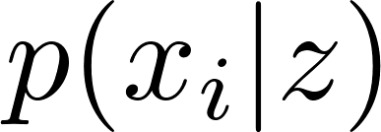
Red * 0.6
Green *0.2
Prior
0.2
0.2
0.2
0.2
0.2
1/9
1/3
1/3
1/9
1/9
Posterior
The posterior distribution of robot being at place x_i given measurement Z.
Conditional probability

Slide 39
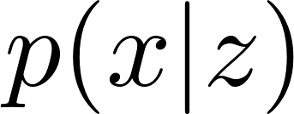
Often, random variables carry information about other random variables. Suppose we already know that Z ’s value is z, and we would like to know the probability that X’s value is x conditioned on that fact.
Conditional probability

Slide 40
Observation model
Red * 0.6
Green *0.2
Prior
0.2
0.2
0.2
0.2
0.2
1/9
1/3
1/3
1/9
1/9
Posterior
Z
Let’s implement this！

Slide 41
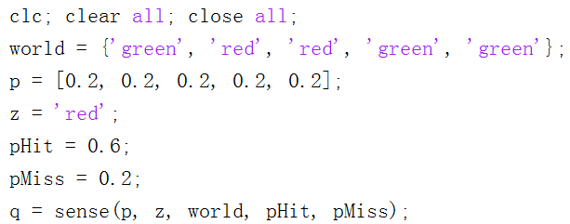
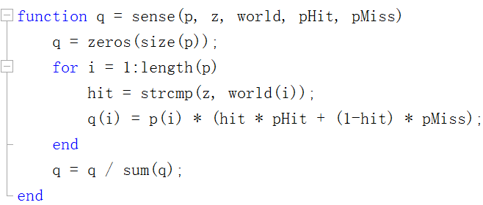
P2

Slide 42
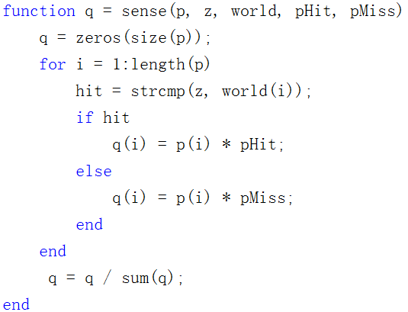
P2

Slide 43
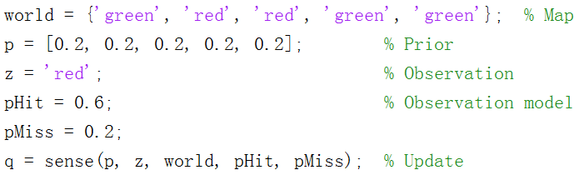
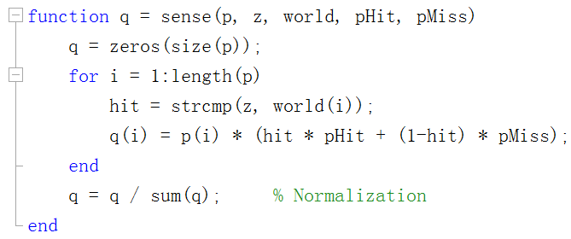
P2

Slide 44
P2

Slide 45
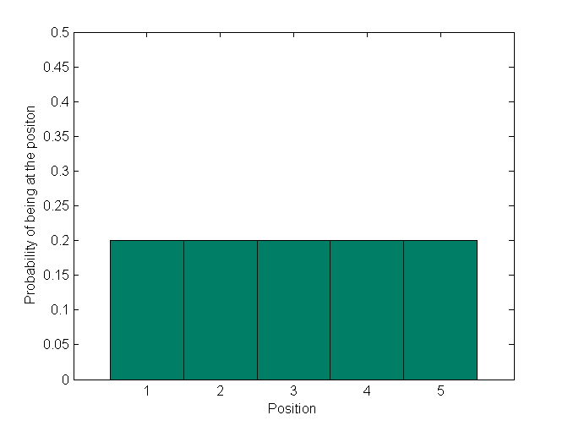
Prior

Slide 46
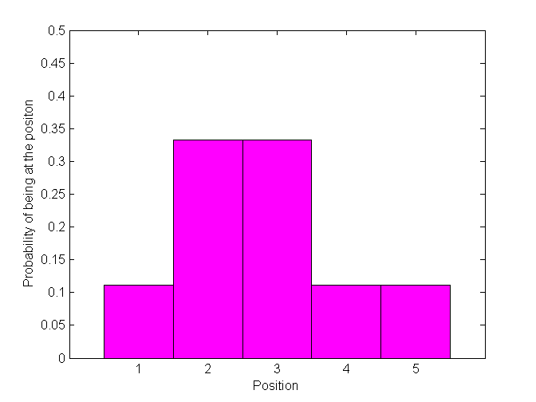
Posterior

Slide 47
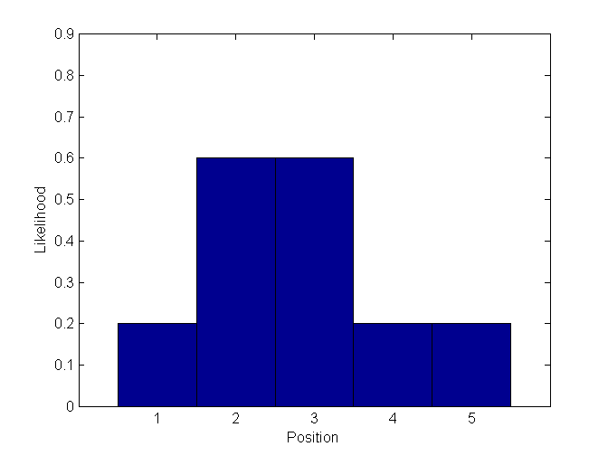

Slide 48

Red * 0.6
Green *0.2
Green* 0.6
Red *0.2
Z
Z
Let’s modify the code to deal with multiple measurements!

Slide 49
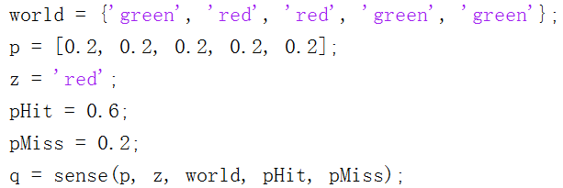
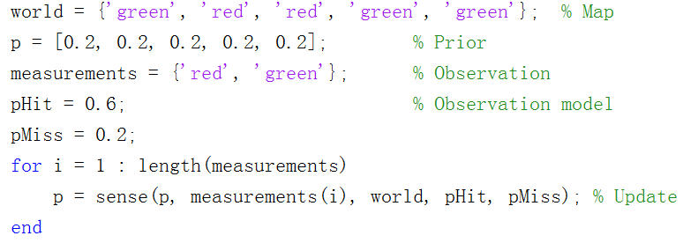
P3

Slide 50
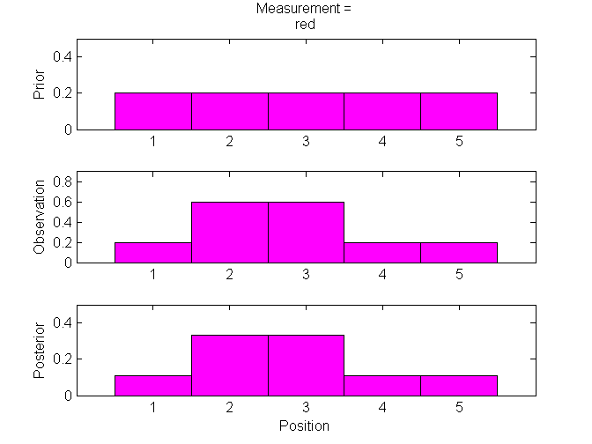
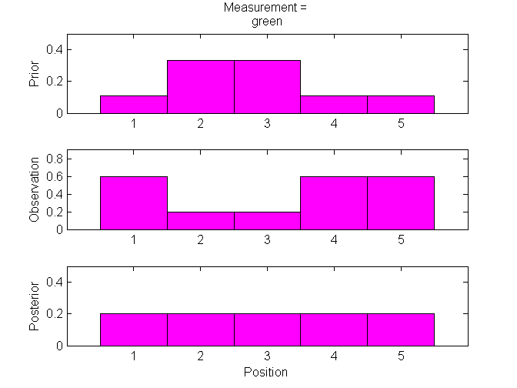
Why is the uniform distribution achieved finally?
P3

Slide 51
P3
Red * 0.6
Green *0.2
Red * 0.6
Green *0.2
Z
Z
Run the code to see the final posterior distribution!

Slide 52
P3
Red * 0.6
Green *0.2
Red * 0.6
Green *0.2
Green* 0.6
Red *0.2
Z
Z
Z
Run the code to see the final posterior distribution!

Slide 53
Implement robot motion…

Slide 54
1/9
1/3
1/3
1/9
1/9
We know the robot moves to the right, and will assume the world is cyclic. So, when the robot reaches the right-most cell, it will circle around back to the first, or left-most cell.

Slide 55
1/9
1/3
1/3
1/9
1/9
Assuming the robot moves exactly one position to the right, what is the probability distribution after the motion?

Slide 56
1/9
1/3
1/3
1/9
1/9
1/9
1/9
1/3
1/3
1/9
Let’s implement this！
Every grid shifts to the right one cell.

Slide 57
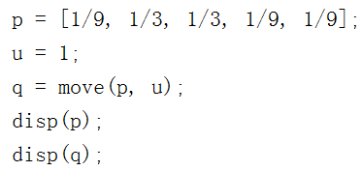
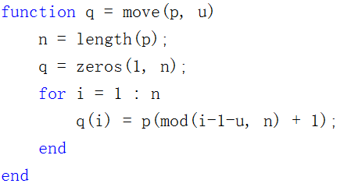
P4
Circular convolution

Slide 58
1/9
1/3
1/3
1/9
1/9
1/9
1/9
1/3
1/3
1/9
Accurate motion
Let’s see inaccurate motion

Slide 59
U = 1
U = 2
0.1
0.8
0.1
Assume the robot executes its action with high probability (0.8), correctly; with small probability (0.1) it will overshoot or undershoot. Note that this is a more accurate model of real robot motion.

Slide 60
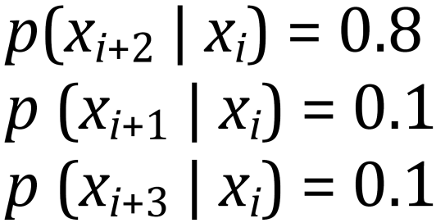
The distribution after the motion given a prior distribution:
U = 2
0.1
0.8
0.1
It is the primary reason why localization is hard, because robots are not very accurate.

Slide 61
0
1
0
0
0
U = 2
What is the distribution after motion?

Slide 62
0
1
0
0
0
0
0
0.1
0.8
0.1
U = 2
As expected, the probability distribution has shifted and spread out. Moving causes a loss of information.

Slide 63
0
0.5
0
0.5
0
Let’s do this again for a different distribution. It is a cyclic motion model as before. What is the posterior?

Slide 64

0
0.5
0
0.5
0
0
0
0.05
0.4
0.05
U = 2
Is this correct?
We answer this in the same way as in the previous question.

Slide 65
0
0.5
0
0.5
0
0.4
0.05
0.05
0.4
0.05
0.05
U = 2
0.4
0.05
0.05
0.4
0.1
Let’s implement this！
We answer this in the same way as in the previous question, but this time we have to take into account that cell 5 can be arrived at in 2 ways: by cell 4 undershooting or cell 2 overshooting.

Slide 66
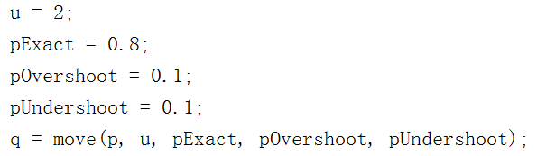
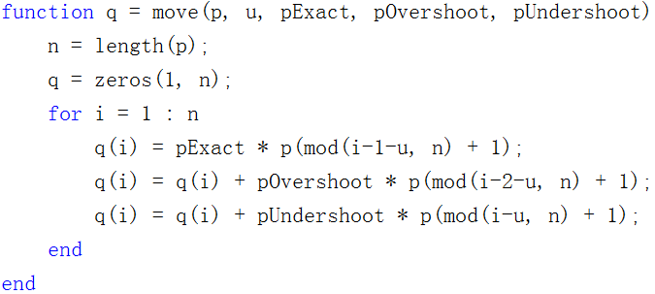
P5

Slide 67
U = 2
0.2
0.2
0.2
0.2
0.2
0.2
0.2
0.2
0.2
0.2
Realize that if we start with a uniform prior distribution (state of maximum confusion), and we then move, we MUST end up with the uniform distribution. Since this problem starts with a state of maximum confusion and then moves (which, remember, never increases our knowledge of the system), we must remain in the maximally confused state.

Slide 68
Let’s implement this！ Robot moves 100 steps without sensing.
1
0
0
0
0
U = 1
What happens if the robot never senses but executes the motion to the right forever, what will be the limit or stationary distribution in the end?

Slide 69
p = [1, 0, 0, 0, 0];
u = 1;
step = 100;
pExact = 0.8;
pOvershoot = 0.1;
pUndershoot = 0.1;
for i = 1 : step
p = move(p, u, pExact, pOvershoot, pUndershoot);
disp(i);
disp(p);
end
P6

Slide 70
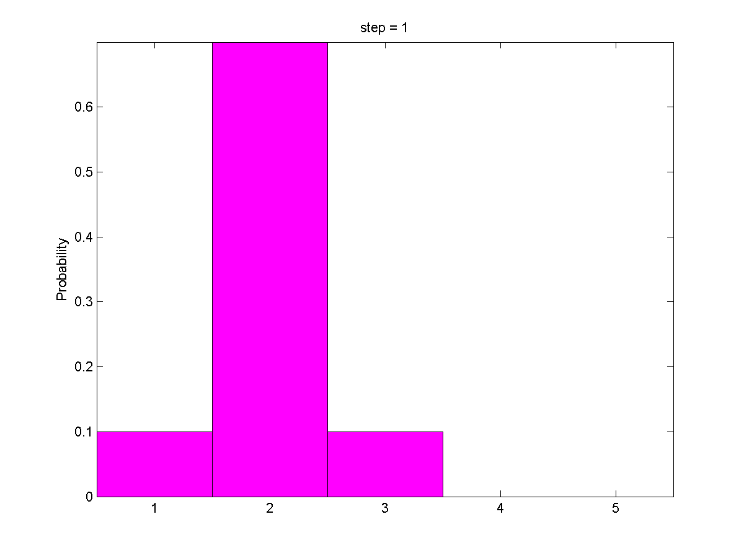

Slide 71
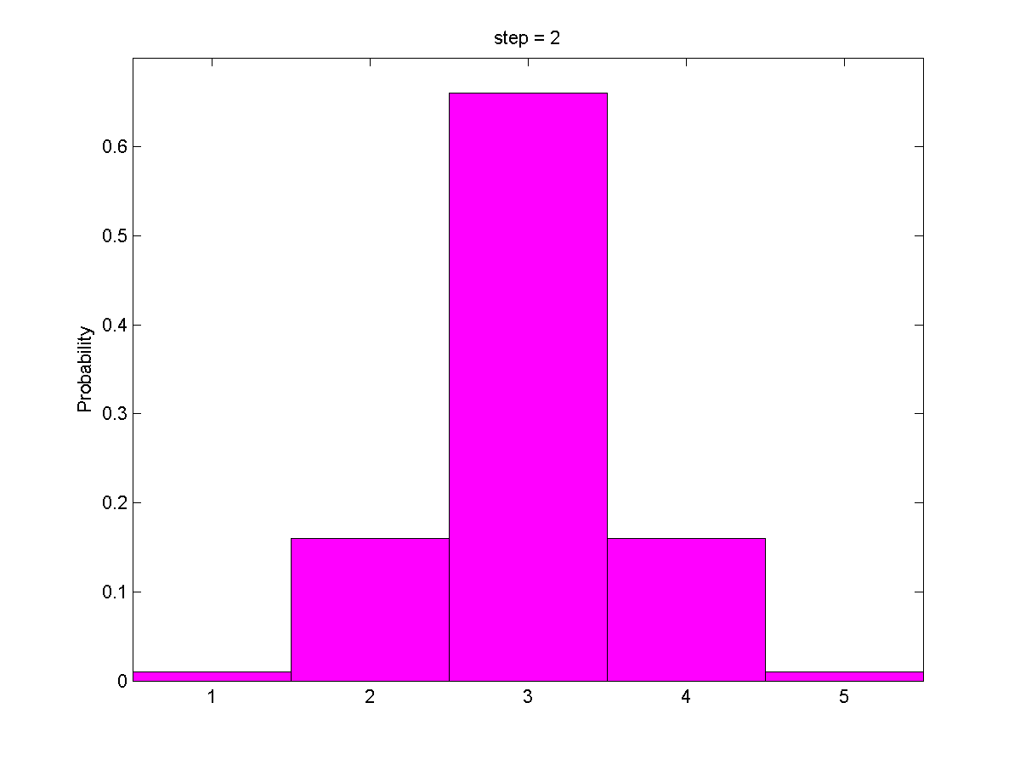

Slide 72
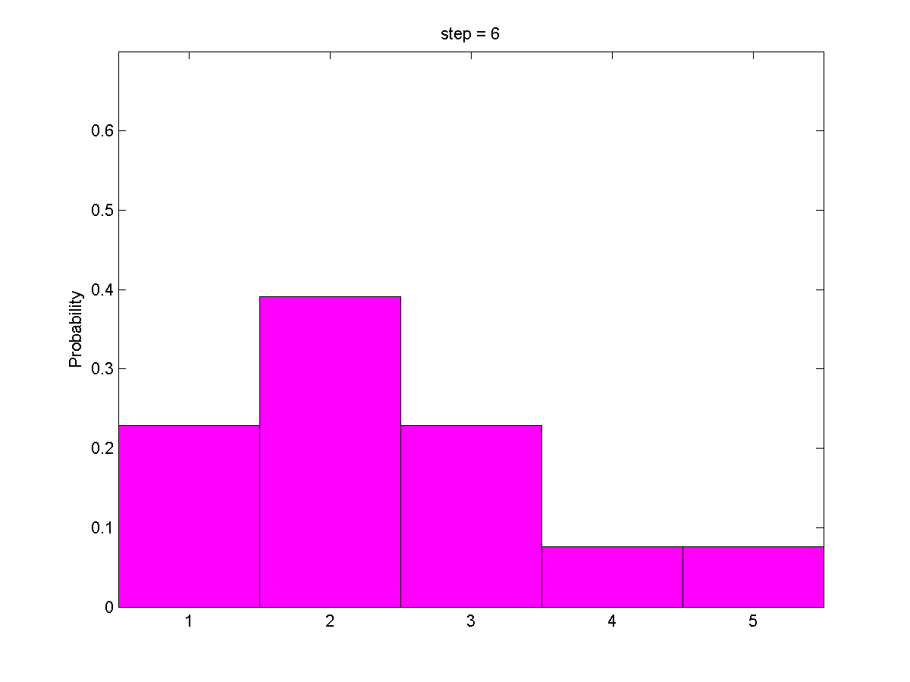

Slide 73
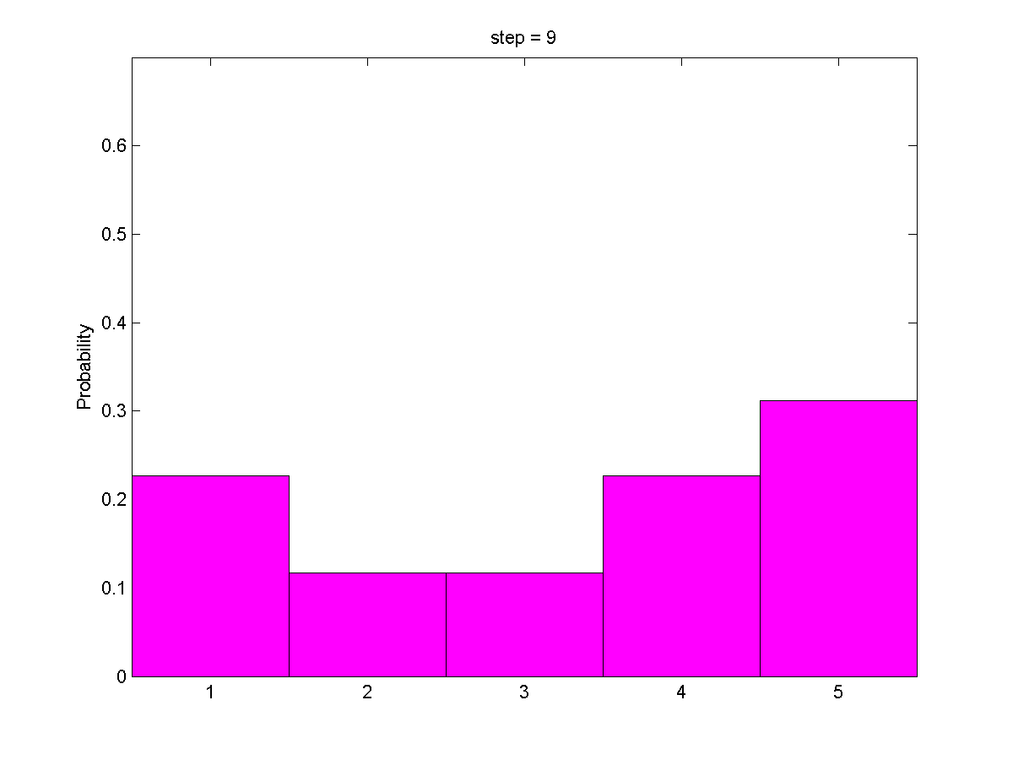

Slide 74
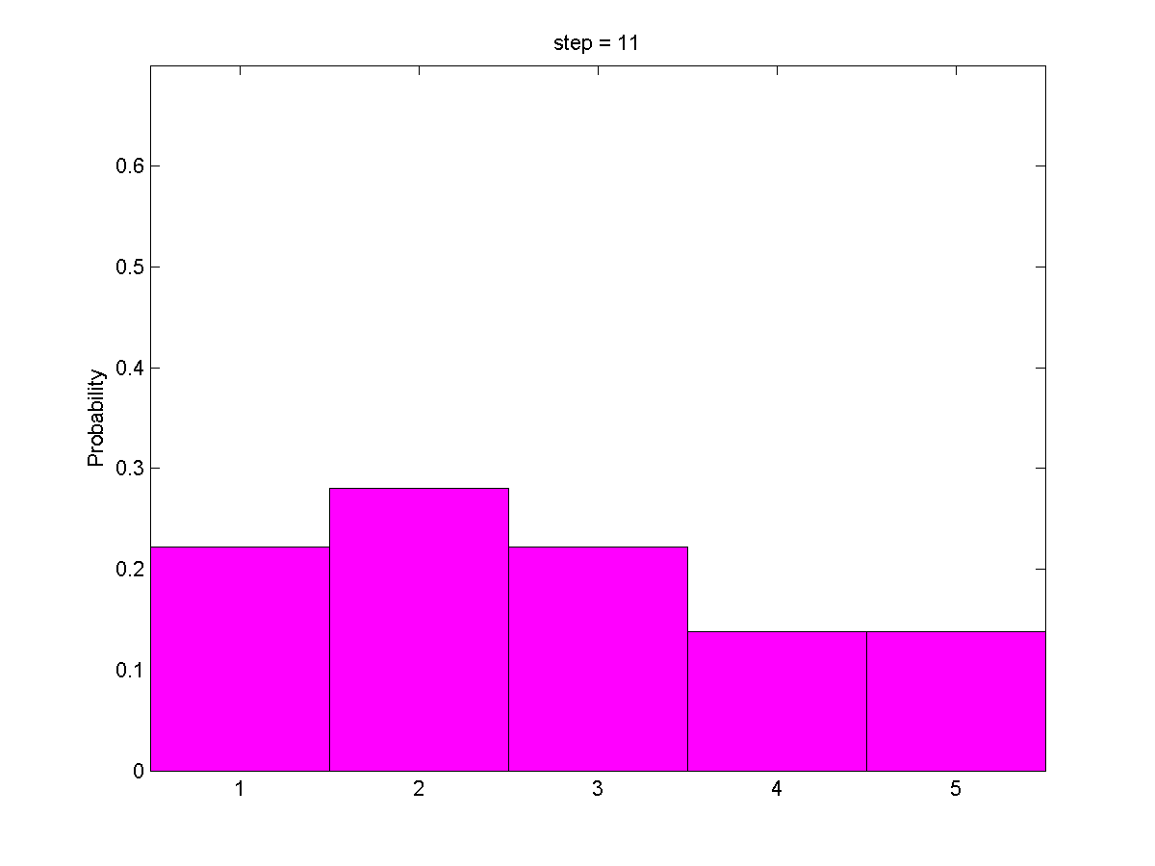

Slide 75
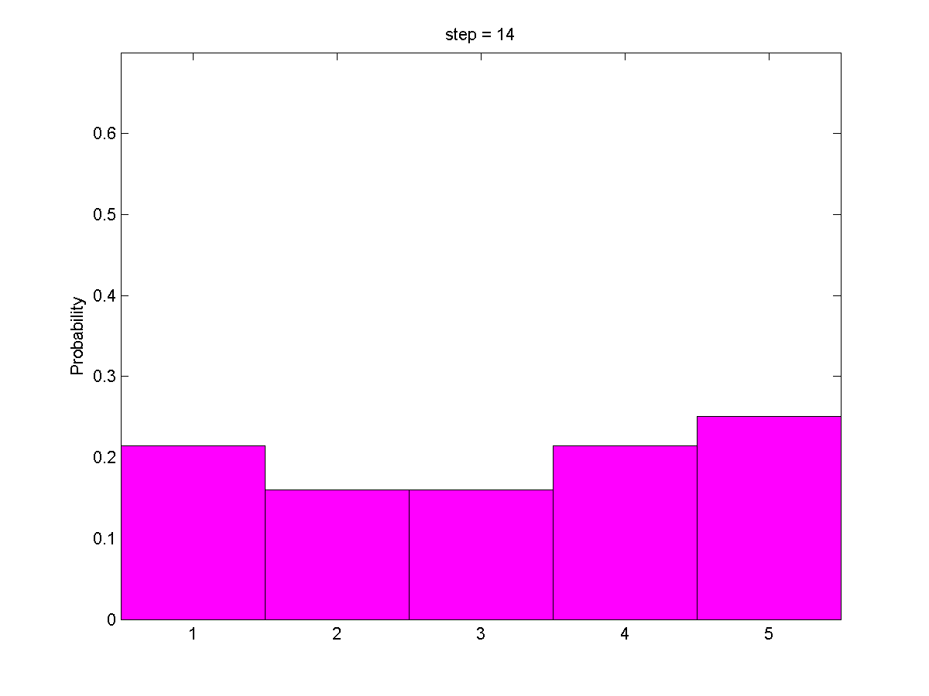

Slide 76
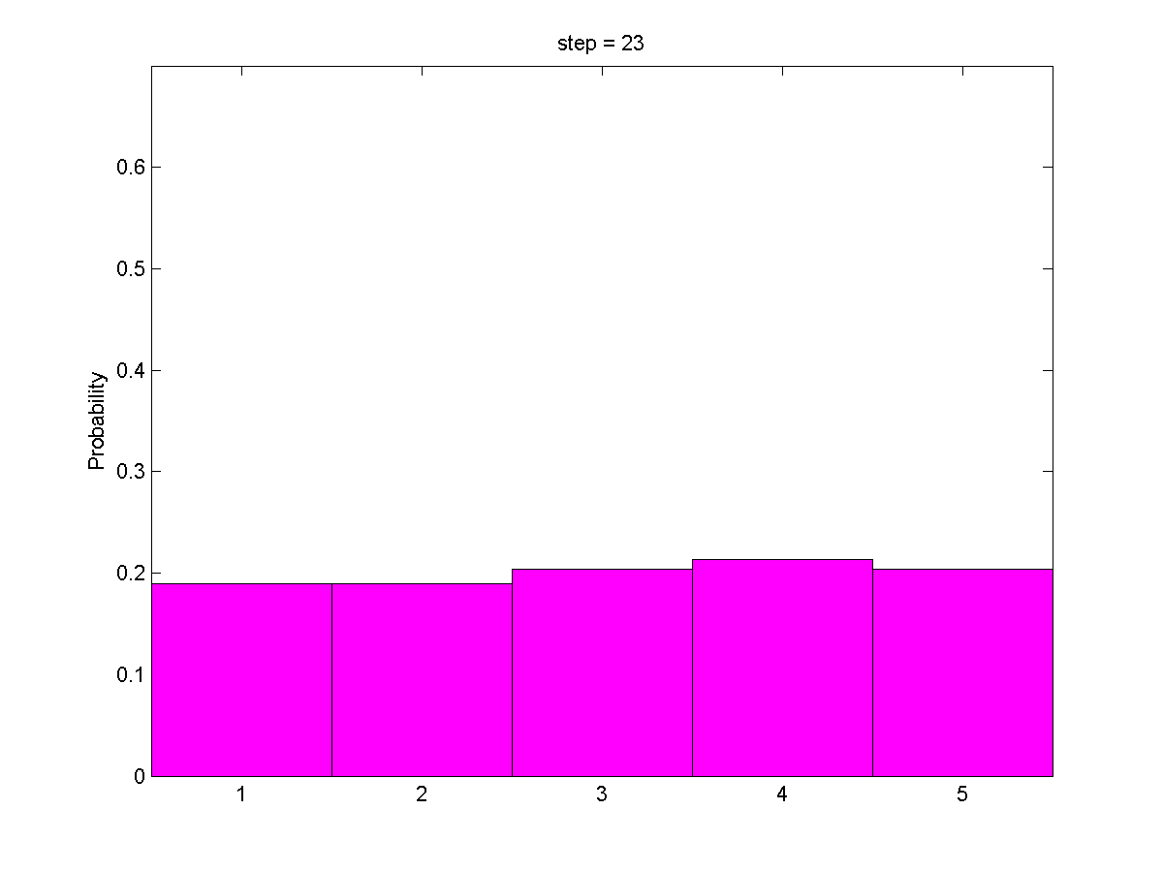

Slide 77
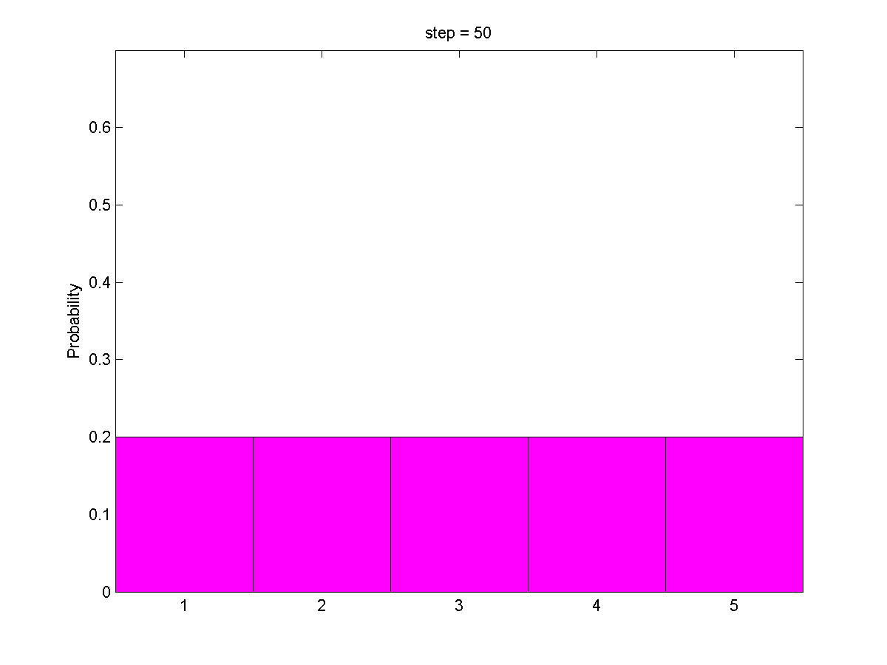

Slide 78
After 50 moves, we have lost essentially all information about the robot's location.
We need to be continuously sensing if we want to know the robot's location.

Slide 79
1
0
0
0
0
U = 1
0.2
0.2
0.2
0.2
0.2
We can also solve for the probability of each cell by realizing that each cell is the possible destination for three other cells.
It is uniform distribution!

Slide 80
Have you realized how crucial sensing is?

Slide 81
Gain information
Sense
Move
Lose information
Initial belief

Slide 82
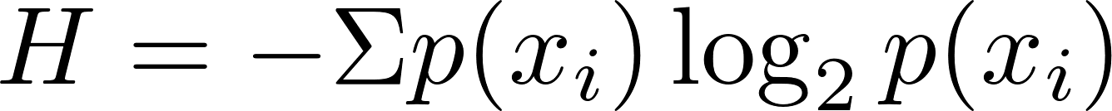

http://en.wikipedia.org/wiki/Entropy_(information_theory)
Entropy
is a measure of the uncertainty in a random variable. In this context, the term usually refers to the Shannon entropy, which quantifies the expected value of the information contained in a message.
Entropy
Informative

Slide 83
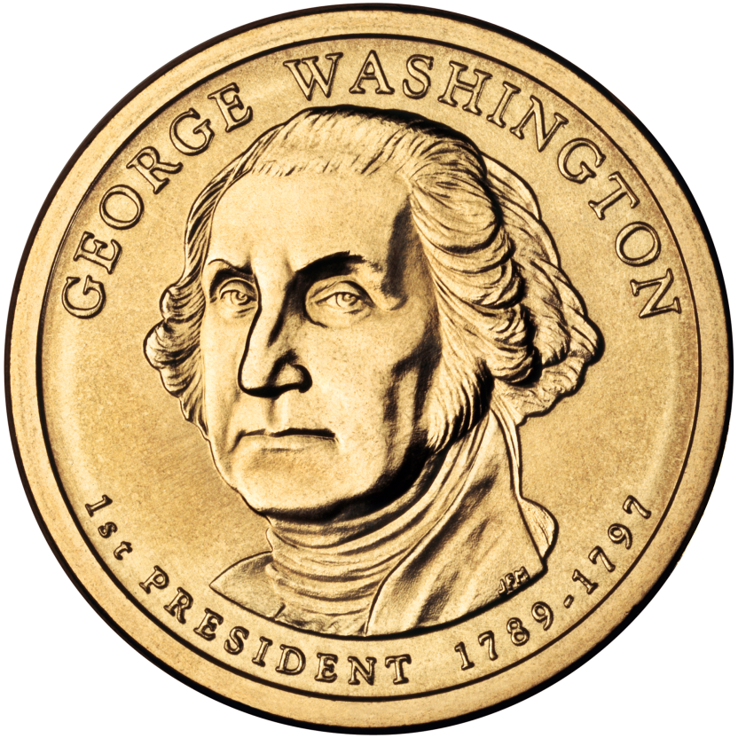
The Entropy when tossing coin
Assuming the probability of being head can be specified (0~1), what will the entropy be?
Let’s implement this！

Slide 84
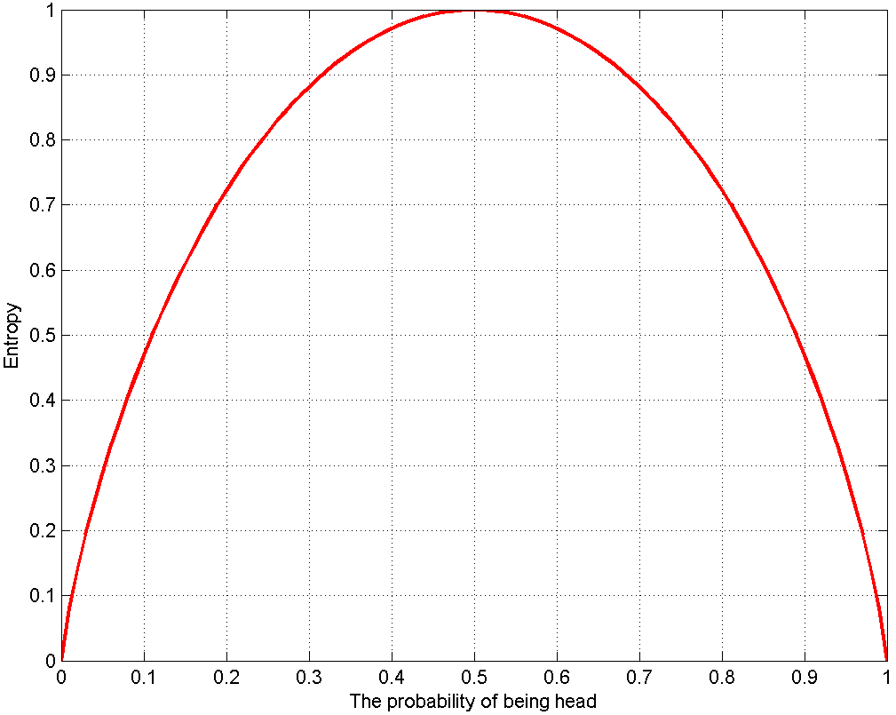

P65

Slide 85
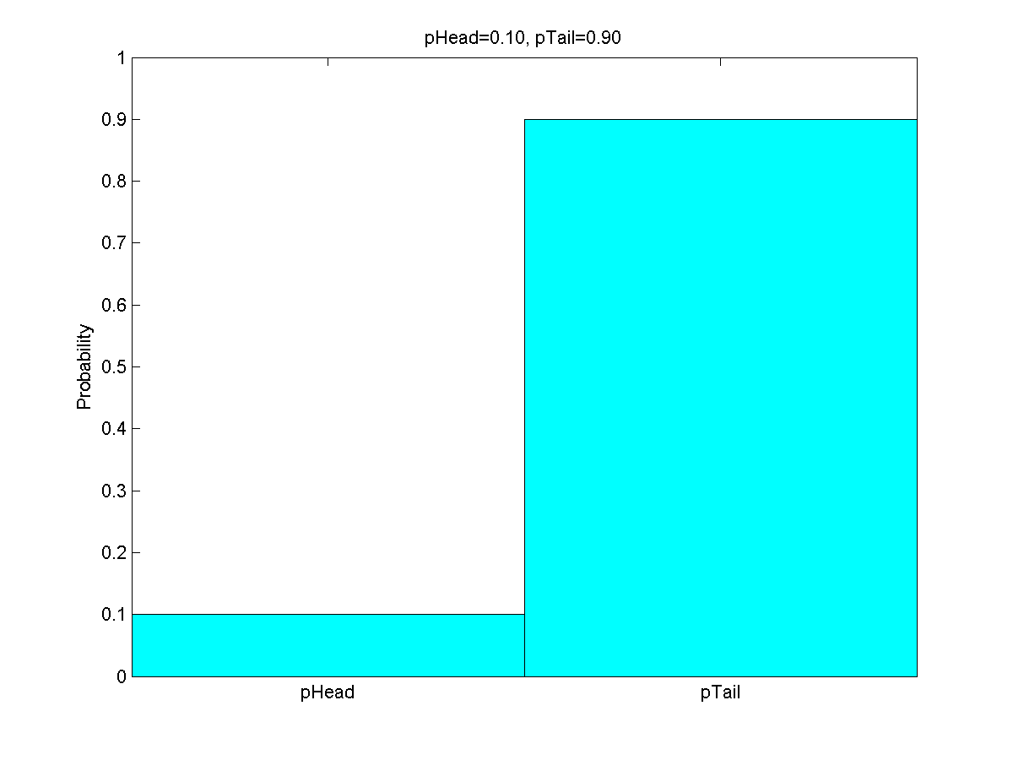



P65

Slide 86
pHead = 0 : 0.01 : 1;
n = length(pHead);
H = zeros(1, n);
for i = 1 : n
p = [pHead(i), 1 - pHead(i)];
if (pHead(i) == 0)
p = 1 - pHead(i);
elseif 1 - pHead(i) == 0;
p = pHead(i);
end
H(i) = -sum(p .* log2(p) );
if mod(pHead(i), 0.1) == 0 && pHead(i)~= 0 && pHead(i) ~= 1
htemp = figure(1);
bar(p,1);
ylim([0,1]);
set(gca, 'XTickLabel', {'pHead', 'pTail'});
ylabel('Probability');
title(sprintf('pHead=%.2f, pTail=%.2f',pHead(i),1-pHead(i)));
colormap(cool);
print(htemp,'-dpng',sprintf('phead=%.2f.png', pHead(i)));
end
end
P65

Slide 87

Which one is most uncertain?
Which one is most informative?

Slide 88
The most uncertain one
The most certain one
Informative?

Slide 89
0.4690
0.8813
1.0000

Slide 90
0.4690
0.8813
1.0000
In an estimation-theoretic context
it is most natural to think of the “most informative” probability distribution as that which assigns all probability to a single state; logically the most compact of probabilities.
Conversely, the “least informative” distribution is one in which probability is spread uniformly over all states and so entropy is a maximum.
Maximum entropy distributions are often used as prior distributions when no useful prior information is available

Slide 91
0.4690
1.0000
0.8813
Most informative
Least informative
In an estimation-theoretic context
it is most natural to think of the “most informative” probability distribution as that which assigns all probability to a single state; logically the most compact of probabilities.
Conversely, the “least informative” distribution is one in which probability is spread uniformly over all states and so entropy is a maximum.
Maximum entropy distributions are often used as prior distributions when no useful prior information is available
Entropy
Informative
Uncertainty

Slide 92
0.4690
0.8813
1.0000
In a communication context
If the result of the experiment is known with high probability a priori, then the actual occurrence of the event is not very informative.
Conversely, if the possibility of each outcome is uniformly distributed, then the outcome itself is most informative.
The outcome of a random experiment is guaranteed to be most informative if the probability distribution over outcomes is uniform.

Slide 93
0.4690
1.0000
0.8813
Least informative
Most informative
In a communication context
If the result of the experiment is known with high probability a priori, then the actual occurrence of the event is not very informative.
Conversely, if the possibility of each outcome is uniformly distributed, then the outcome itself is most informative.
The outcome of a random experiment is guaranteed to be most informative if the probability distribution over outcomes is uniform.
Entropy
Informative
Uncertainty

Slide 94
In an estimation-theoretic context
Entropy
Informative
Uncertainty
In a communication context
Entropy
Informative
Uncertainty

Slide 95

In an estimation-theoretic context
Entropy
Informative
Uncertainty
Localization complies with this rule!

Slide 96
In an estimation-theoretic context
Entropy
Informative
Uncertainty
Let’s demonstrate the rule with robot motion!

Slide 97
entropy = zeros(1, step);
for i = 1 : step
p = move(p, u, pExact, pOvershoot, pUndershoot);
entropy(i) = -sum(p .* log2(p) );
disp(i);
disp(p);
end
h = figure(1);
hold on;
plot(1:step,entropy, '-','linewidth', 2,'color', 'g');
plot(1:step,entropy, '^','linewidth', 1.5,'color', 'r');
xlabel('Motion step');
ylabel('Entropy');
print(h, '-dpng', 'entropy.png');
P7

Slide 98

Entropy
Informative
Uncertainty
P7

Slide 99
Z
Z
U = 1
U = 1
Where am I?
Which cell will robot be most probably next to after the two measurements and the two motions?

Slide 100
Z
Z
U = 1
U = 1
I am probably here!
Let’s implement this！
We find the robot most likely in right-most cell

Slide 101
p = [0.2, 0.2, 0.2, 0.2, 0.2]; % Prior
world = {'green', 'red', 'red', 'green', 'green'}; % Map
%% First configuration of meas. & motion
measurements = {'red', 'green'}; % Observation
motions = [1, 1];
%% Observation model
pHit = 0.6;
pMiss = 0.2;
%% Motion model / Process model
pExact = 0.8;
pOvershoot = 0.1;
pUndershoot = 0.1;
%% The recursive sensing and moving
entropy = zeros(2, length(motions));
for i = 1 : length(measurements)
%% Update by sensing
p = sense(p, measurements(i), world, pHit, pMiss);
entropy(1,i) = -sum(p .* log2(p) );
%% Predict by moving
p = move(p, motions(i), pExact, pOvershoot, pUndershoot);
entropy(2,i) = -sum(p .* log2(p) );
end
First configuration
P8

Slide 102

0.2116 0.1516 0.0811 0.1684 0.3874
entropy(end, end) = 2.1433
P8

Slide 103

Entropy
Informative
Uncertainty
Predict
Predict
Update
P8
entropy(end, end) = 2.1433

Slide 104


world = {'green', 'red', 'red', 'green', 'green'};
measurements = {'red', 'green', 'green'};
motions = [1, 1, 1];
Second configuration
0.4118 0.2522 0.0761 0.0515 0.2085
entropy(end, end) = 2.0030

Slide 105


world = {'green', 'red', 'red', 'green', 'green'};
measurements = {'green', 'red'};
motions = [1, 1];
Third configuration
0.1400 0.1853 0.3884 0.2021 0.0842
entropy(end, end) = 2.1445

Slide 106


world = {'green', 'red', 'red', 'green', 'green'};
measurements = {'green', 'green'};
motions = [3, 1];
Fourth configuration
0.1907 0.1645 0.1355 0.1645 0.3449
entropy(end, end) = 2.2329

Slide 107


world = {'green', 'red', 'red', 'green', 'green'};
measurements = {‘red', 'red'};
motions = [3, 1];
Fifth configuration
0.1970 0.2149 0.2582 0.2149 0.1149
entropy(end, end) = 2.2783

Slide 108

world = {'green', 'red', 'red', 'green', 'green'};
measurements = {'red', 'red'};
motions = [2, 1];
Sixth configuration
0.1970 0.1149 0.2149 0.2582 0.2149
entropy(end, end) = 2.2783

Slide 109








Configuration ID | Correctness | Sharpest peek of posterior | Final entropy | Visualization of posterior
First |  | 0.3874 | 2.1433
Second |  | 0.4118 | 2.0030
Third |  | 0.3884 | 2.1445
Fourth |  | 0.3449 | 2.2329
Fifth |  | 0.2582 | 2.2783
Sixth |  | 0.2582 | 2.2783

Slide 110
The probability distribution we pursuit should have two qualities:
It should have one sharp peak. This indicates that the robot has a very specific belief about its current location.
The peak should be correct! If this weren't true, the car would believe--very strongly--that it was in the wrong location. This would be bad .

Slide 111
That’s the essence of mobile robot localization!

Slide 112
The localization procedure can be written as a series of steps:
1. Start with a belief set about our current location.
2. Multiply this distribution by the results of our sense measurement.
3. Normalize the resulting distribution.
4. Move by performing a convolution. This sounds more complicated than it really is: this step really involved multiplication and addition to obtain the new probabilities at each

Slide 113
You may be curious about how we can use individual cells to represent a road. After all, a road isn't neatly divided into cells for us to jump between. Mathematically, we would say the road is not discrete it is continuous. Initially, this seems like a problem. Fortunately, whenever we have a situation where we don't need exact precision, we can chop a continuous distribution into pieces and make those pieces as small as we need.
To use continuous probability distributions to describe beliefs, we need Kalman filter-liked algorithms…

Slide 114
Extend 1D to 2D

Slide 115
Let’s model the 2D world as a set of colored cells.

Slide 116


Slide 117
Motion commands:
[0, 0] Keep stationary
[0, 1] Move right
[0, -1] Move left
It is also cyclic.
[1, 0] Move down
[-1, 0] Move up

Slide 118
The motion is executed correctly at a probability of 0.8. When the motion fails, the robot won’t move at all
[0, 0] Keep stationary
[0, 1] Move right
Let’s implement this！
[0, -1] Move left
[1, 0] Move down
[-1, 0] Move up

Slide 119
world = {'red', 'green', 'green', 'red' , 'red';
'red', 'red', 'green', 'red', 'red';
'red', 'red', 'green', 'green', 'red';
'red', 'red', 'red', 'red', 'red'}; % Map
nRow = size(world, 1);
nCol = size(world, 2);
pStart = 0.7;
p = (1 - pStart) / (nRow * nCol-1) * ones(nRow, nCol);% Prior
p(3, 2) = pStart;
stop = [0, 0];
right = [0, 1];
left = [0,-1];
down = [1, 0];
up = [-1,0];
motions = {right};
pMoveCorrect = 0.8;
q = move(p, cell2mat(motions(1)), pMoveCorrect);
P9

Slide 120
function q = move(p, u, pMoveCorrect)
nRow = size(p, 1);
nCol = size(p, 2);
q = zeros(nRow, nCol);
for r = 1 : nRow
for c = 1 : nCol
q(r, c) = pMoveCorrect * ...
p(mod(r-1-u(1), nRow) + 1, mod(c-1-u(2), nCol) + 1)...
+ (1 - pMoveCorrect) * p(r, c);
end
end
end
function [r, c] = maxMat(g)
% Find the index of the largest element of g
[temp,r] = max(g);
[~,c] = max(temp);
r = r(c);
end
P9

Slide 121
The Prior:
0.0150 0.0150 0.0150 0.0150 0.0150
0.0150 0.0150 0.0150 0.0150 0.0150
0.0150 0.7000 0.0150 0.0150 0.0150
0.0150 0.0150 0.0150 0.0150 0.0150
The probability after moving:
0.0150 0.0150 0.0150 0.0150 0.0150
0.0150 0.0150 0.0150 0.0150 0.0150
0.0150 0.1520 0.5630 0.0150 0.0150
0.0150 0.0150 0.0150 0.0150 0.0150
The largest probability 0.5630 occurs at cell (3, 3)

Slide 122

P9

Slide 123

P9

Slide 124
The Prior:
0.0150 0.0150 0.7000 0.0150 0.0150
0.0150 0.0150 0.0150 0.0150 0.0150
0.0150 0.0150 0.0150 0.0150 0.0150
0.0150 0.0150 0.0150 0.0150 0.0150
The probability after moving:
0.0150 0.0150 0.1520 0.0150 0.0150
0.0150 0.0150 0.0150 0.0150 0.0150
0.0150 0.0150 0.0150 0.0150 0.0150
0.0150 0.0150 0.5630 0.0150 0.0150
The largest probability 0.5630 occurs at cell (4, 3)

Slide 125


Slide 126


Slide 127
The sensor measurement is correct at a probability of 0.7
Let’s implement this！

Slide 128
function q = sense(p, z, world, pSenseCorrect)
nRow = size(p, 1);
nCol = size(p, 2);
q = zeros(nRow, nCol);
for r = 1 : nRow
for c = 1 : nCol
hit = strcmp(z, world(r, c));
q(r, c) = p(r, c) *...
(hit * pSenseCorrect + (1-hit) * (1 - pSenseCorrect));
end
end
q = q / sum(sum(q));
end
pSenseCorrect = 0.7;
q = sense(p, cell2mat(measurements(1)), world, pSenseCorrect);
measurements = {'green'};
P10

Slide 129
The Prior:
0.0150 0.0150 0.0150 0.0150 0.0150
0.0150 0.0150 0.0150 0.0150 0.0150
0.0150 0.7000 0.0150 0.0150 0.0150
0.0150 0.0150 0.0150 0.0150 0.0150
The probability after sensing:
0.0138 0.0323 0.0323 0.0138 0.0138
0.0138 0.0138 0.0323 0.0138 0.0138
0.0138 0.6452 0.0323 0.0323 0.0138
0.0138 0.0138 0.0138 0.0138 0.0138
P10

Slide 130
motions = {stop, right, down, down, right};
measurements = {'green', 'green', 'green' ,'green', 'green'};
Move
Sense
Which cell will robot be most probably at after these motions and measurements?

Slide 131
motions = {stop, right, down, down, right};
measurements = {'green', 'green', 'green' ,'green', 'green'};
Move
Sense
The robot will be at cell (3, 4)
Let’s implement this！

Slide 132




Move
Sense

Slide 133


The Posterior:
0.0111 0.0246 0.0680 0.0447 0.0247
0.0072 0.0102 0.0870 0.0799 0.0094
0.0074 0.0089 0.1127 0.3535 0.0407
0.0091 0.0072 0.0143 0.0431 0.0364
The largest probability 0.3535 occurs at cell (3, 4)

Slide 134

Entropy
Informative
Uncertainty
Update
Predict
P11

Slide 135
pMoveCorrect = 0.8;
pSenseCorrect = 0.7;
compEntropy = inline('-sum(sum(p .* log2(p)))'); % Inline function
p = 1 / (nRow * nCol - 1) * ones(nRow, nCol); % Prior
%% Fisrt configuration
motions = {stop, right, down, down, right};
measurements = {'green', 'green', 'green' ,'green', 'green'};
%% Check the size
if length(motions) ~= length(measurements)
error('The variable ''motions'' should be of the same size as ''measurements''!');
end
entropy = zeros(2, length(motions));
%% The main loop
for i = 1 : length(motions)
p = move(p, cell2mat(motions(i)), pMoveCorrect);
p0 = p;
p = sense(p, cell2mat(measurements(i)), world, pSenseCorrect);
%% Compute entropy
entropy(:, i) = [compEntropy(p0); compEntropy(p)];
end
%% Locate the final cell
[r, c] = maxMat(p);
fprintf('The largest probability %.4f occurs at cell (%d, %d)\n ',...
p(r,c), r, c);
P11

Slide 136

Histogram filter

Slide 137

Histogram Demo
http://veterobot.com/
An open sourced and 3D printed robot

Slide 138
Assignment 2
Give a presentation covering following topics:
Bayes filter
Mathematical derivation of Bayes filter
2. Preview/Review P1-P8 following this slides.
The talk shouldn’t be longer than 15 minutes.
Involving some coding-based simulations is better.

Slide 139
Assignment 3
Give a presentation covering following topic:
Circular convolution
2. Share your understanding of P8.
The talk shouldn’t be longer than 15 minutes.
Involving some coding-based simulations is better.

